Slide 1
Introduction to Integer Programming
Dr. Goutam Sen
Assistant Professor
Industrial and Systems Engineering
Indian Institute of Technology, Kharagpur

Slide 2
References
Hamdy. A. Taha (2002) Operations Research: An Introduction, 8th edition, Prentice Hall of India.
F. Hillier and G. Lieberman (2005) Introduction to Operations Research, 8th edition, McGraw-Hill.
G. L. Nemhauser and L. A. Wolsey, Integer and Combinatorial Optimization, Wiley, 1999.

Slide 3
Some Definitions
Integer linear Programming(ILP)
Mixed Integer Program(MIP)
Binary Integer Program(BIP)

Slide 4
An Example: Capital Budgeting
 | Expenditure(million $)/yr
Project | 1 | 2 | 3 | Returns (million $)
1 | 5 | 1 | 8 | 20
2 | 4 | 7 | 10 | 40
3 | 3 | 9 | 2 | 20
4 | 7 | 4 | 1 | 15
5 | 8 | 6 | 10 | 30
Available funds(million $) | 25 | 25 | 25

Slide 5
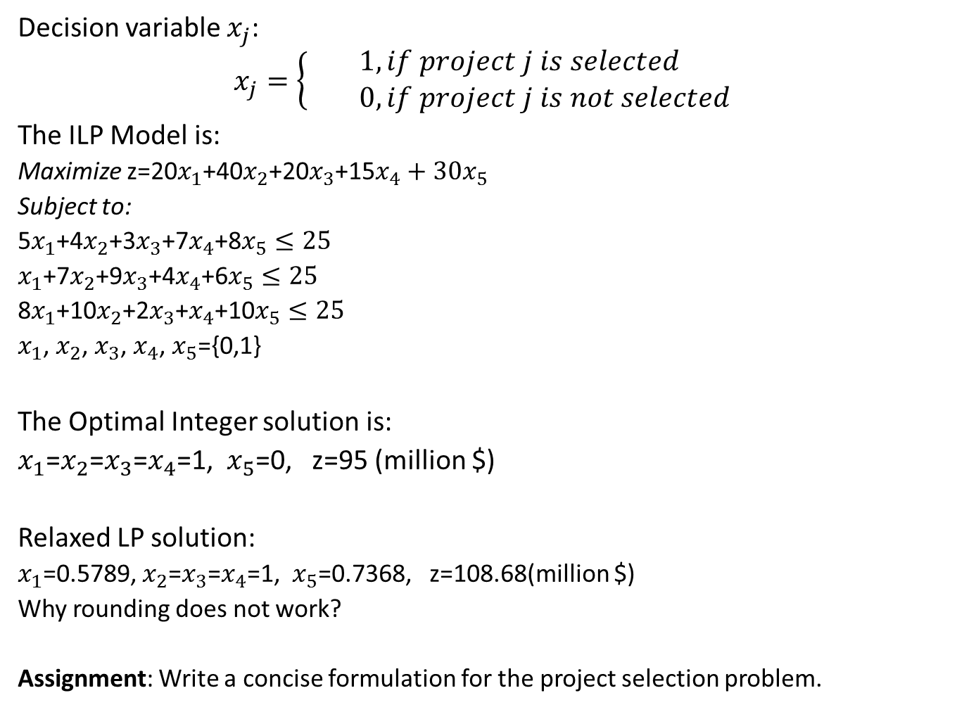
Formulation
Decision variable $x_{j}$:
$$x_{j}=\left\{\begin{aligned}1, if project j is selected \\ 0, if project j is not selected\end{aligned}\right.$$
The ILP Model is:
Maximize z=20$x_{1}$+40$x_{2}$+20$x_{3}$+15$x_{4}+30x_{5}$
Subject to:
5$x_{1}$+4$x_{2}$+3$x_{3}$+7$x_{4}$+8$x_{5}≤25$
$x_{1}$+7$x_{2}$+9$x_{3}$+4$x_{4}$+6$x_{5}≤25$
8$x_{1}$+10$x_{2}$+2$x_{3}$+$x_{4}$+10$x_{5}≤25$
$x_{1}$, $x_{2}$, $x_{3}$, $x_{4}$, $x_{5}$={0,1}
The Optimal Integer solution is:
$x_{1}$=$x_{2}$=$x_{3}$=$x_{4}$=1, $x_{5}$=0, z=95 (million $)
Relaxed LP solution:
$x_{1}$=0.5789, $x_{2}$=$x_{3}$=$x_{4}$=1, $x_{5}$=0.7368, z=108.68(million $)
Why rounding does not work?
Assignment: Write a concise formulation for the project selection problem.

Slide 6
Set Covering Problem
1
Street A
2
Street B
3
Street I
Street K
Street F
Street C
Street G
4
5
Street H
Street J
Street E
Street D
8
7
6

Slide 7

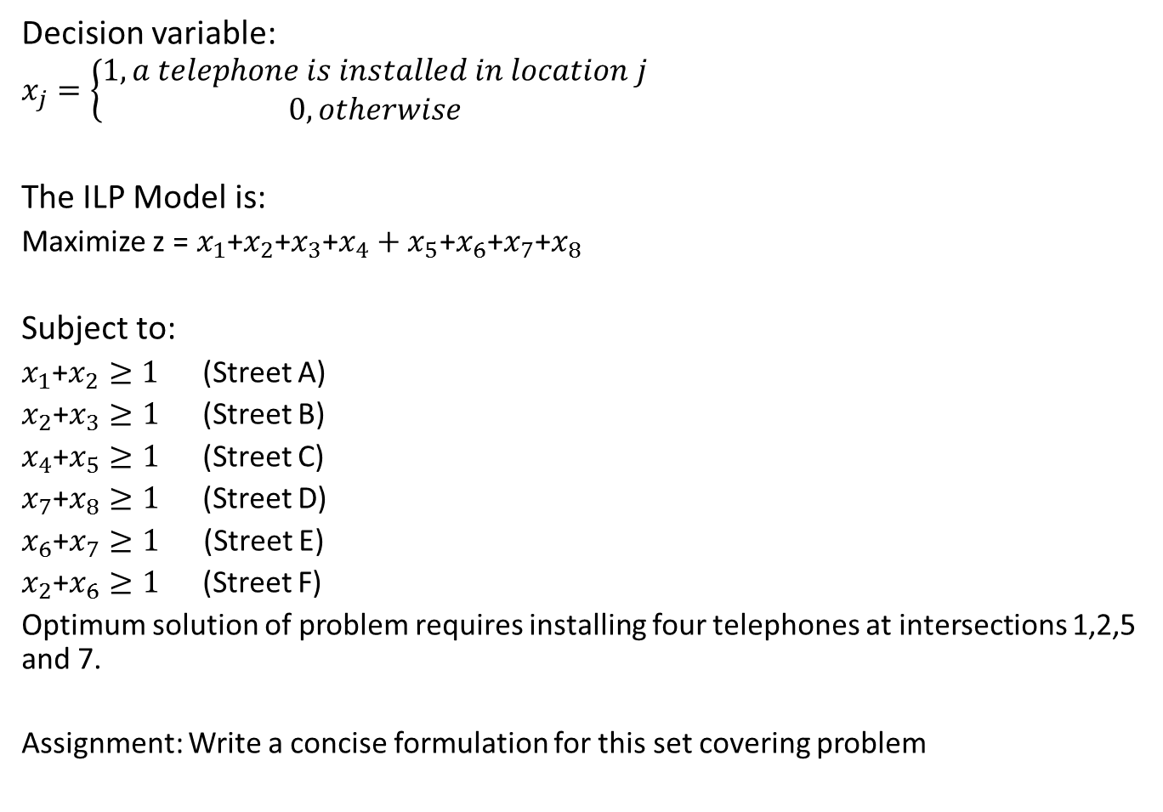
Formulation
Decision variable:
$$x_{j}=\left\{\begin{aligned}1, a telephone is installed in location j \\ 0, otherwise\end{aligned}\right.$$
The ILP Model is:
Maximize z =${ x}_{1}$+$x_{2}$+$x_{3}$+$x_{4}+x_{5}$+$x_{6}$+$x_{7}$+$x_{8}$
Subject to:
$x_{1}$+$x_{2}≥1$ (Street A)
$x_{2}$+$x_{3}≥1$(Street B)
$x_{4}$+$x_{5}≥1$(Street C)
$x_{7}$+$x_{8}≥1$(Street D)
$x_{6}$+$x_{7}≥1$ (Street E)
$x_{2}$+$x_{6}≥1$(Street F)
Optimum solution of problem requires installing four telephones at intersections 1,2,5 and 7.
Assignment: Write a concise formulation for this set covering problem
$x_{1}$+$x_{6}≥1$(Street G)
$x_{4}$+$x_{7}≥1$(Street H)
$x_{2}$+$x_{4}≥1$(Street I)
$x_{5}$+$x_{8}≥1$(Street J)
$x_{3}$+$x_{5}≥1$(Street K)
$x_{j}$=(0,1), j=1,2,………,8

Slide 8

Either-Or Constraints
Either 3$x_{1}$ + 2$x_{2}≤18$
Or $x_{1}$ + 4$x_{2}$ $≤16$
These two above inequalities are equivalent to:
3$x_{1}$ + 2$x_{2}≤18$ + My
$x_{1}$ + 4$x_{2}$ $≤16$ + M(1-y)
where, y is an auxiliary variable must be 0 or 1.
Assignment:
y=min($u_{1}$, $u_{2})$ , Write a formulation to find y.
How to represent either-or variables?

Slide 9
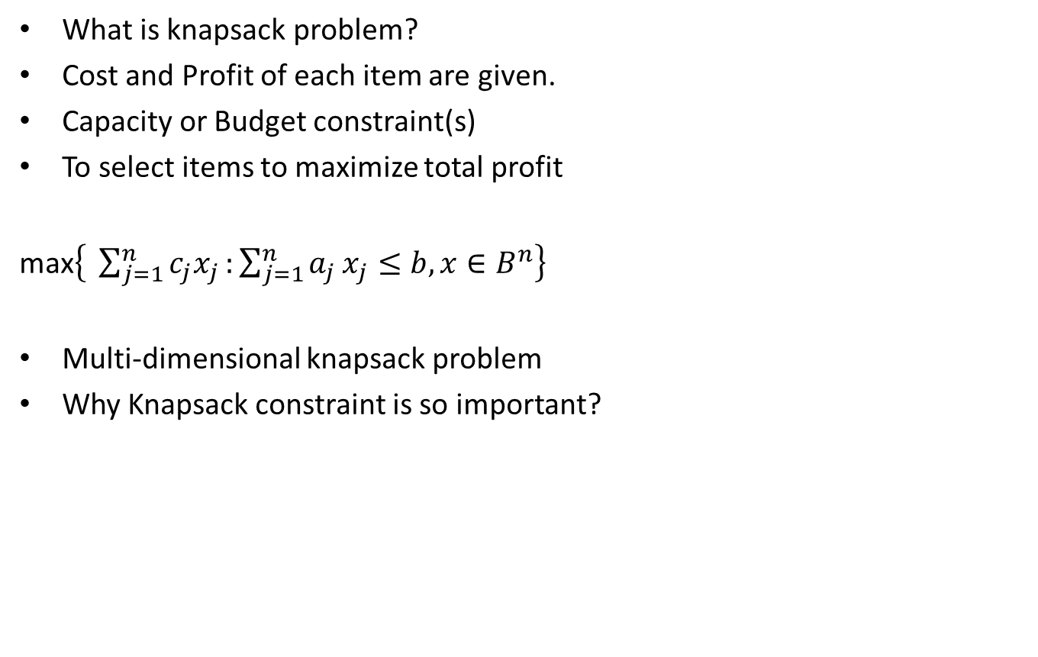
0-1 Knapsack Problem
What is knapsack problem?
Cost and Profit of each item are given.
Capacity or Budget constraint(s)
To select items to maximize total profit
max$\left\{ \sum_{j=1}^{n}{c_{j}x_{j}}\text{:}\sum_{j=1}^{n}{a_{j}}x_{j}≤b, x∈B^{n}\right\}$
Multi-dimensional knapsack problem
Why Knapsack constraint is so important?

Slide 10

Assignment Problem
Objective function:
Minimize $\sum_{i=1}^{m}{\sum_{j=1}^{n}{c_{ij}x_{ij}}}$
Subject to:
$\sum_{j=1}^{n}{x_{ij}}$=1 for i=1,…..,m
$\sum_{i=1}^{m}{x_{ij}}≤$1 for j=1,…..,n
$x_{ij}$={0,1}
Can you solve this problem without using any solver?
Special characteristic of the formulation – totally unimodular

Slide 11
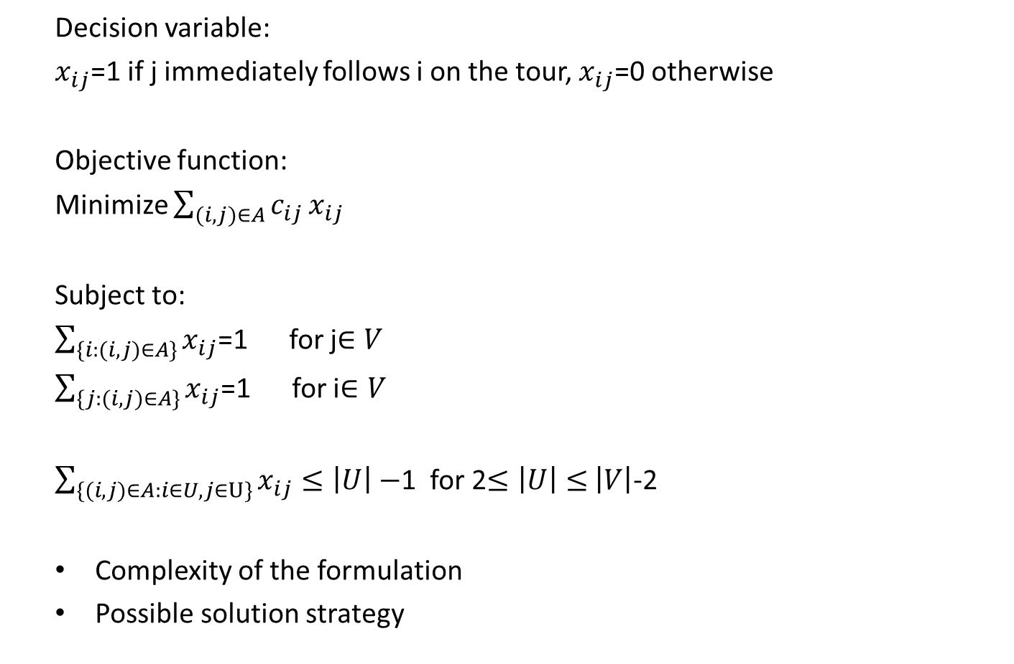
Traveling Salesman Problem
Decision variable:
$x_{ij}$=1 if j immediately follows i on the tour, $x_{ij}$=0 otherwise
Objective function:
Minimize $\sum_{(i,j)∈A}{c_{ij}}x_{ij}$
Subject to:
$\sum_{\{i:(i,j)∈A\}}{x_{ij}}$=1 for j$∈V$
$\sum_{\{j:(i,j)∈A\}}{x_{ij}}$=1 for i$∈V$
$\sum_{\{(i,j)∈A:i∈U,j∈U\}}{x_{ij}}≤\left|U\right|−$1 for 2$≤\left|U\right|≤$ $\left|V\right|$-2
Complexity of the formulation
Possible solution strategy

Slide 12
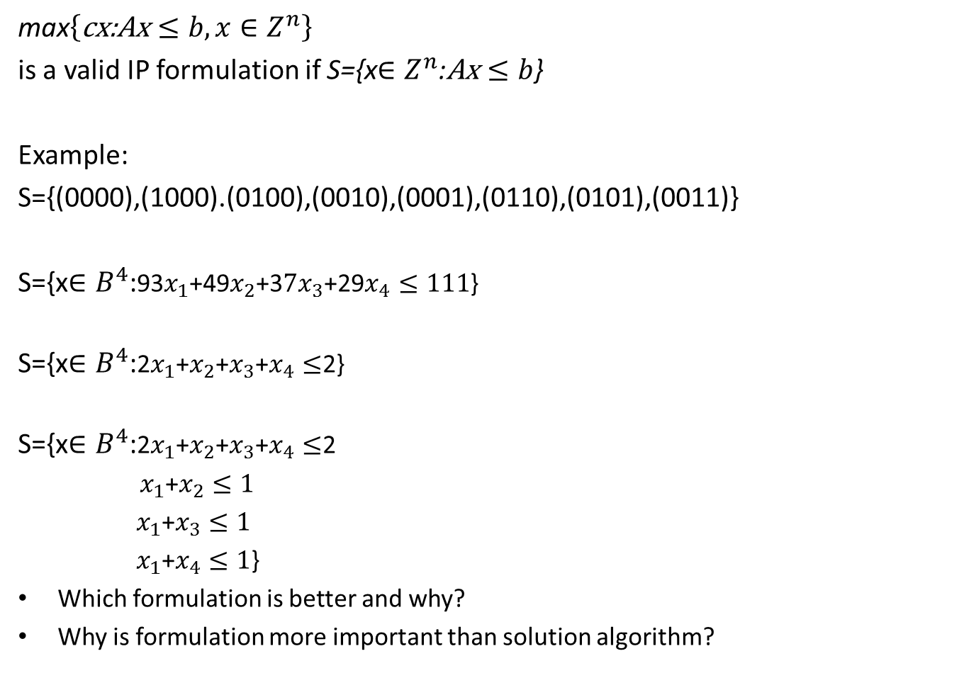
Choices in Model Formulation
max$\left\{\text{cx}\text{:}\text{Ax}≤b, x∈Z^{n}\right\}$
is a valid IP formulation if S={x$∈Z^{n}$:$\text{Ax}≤b$}
Example:
S={(0000),(1000).(0100),(0010),(0001),(0110),(0101),(0011)}
S={x$∈B^{4}$:93$x_{1}$+49$x_{2}$+3${7x}_{3}$+29$x_{4}≤111$}
S={x$∈B^{4}$:2$x_{1}$+$x_{2}$+$x_{3}$+$x_{4}≤$2}
S={x$∈B^{4}$:2$x_{1}$+$x_{2}$+$x_{3}$+$x_{4}≤$2
$x_{1}$+$x_{2}≤1$
${ x}_{1}$+$x_{3}≤1$
${ x}_{1}$+$x_{4}≤1$}
Which formulation is better and why?
Why is formulation more important than solution algorithm?

Slide 13
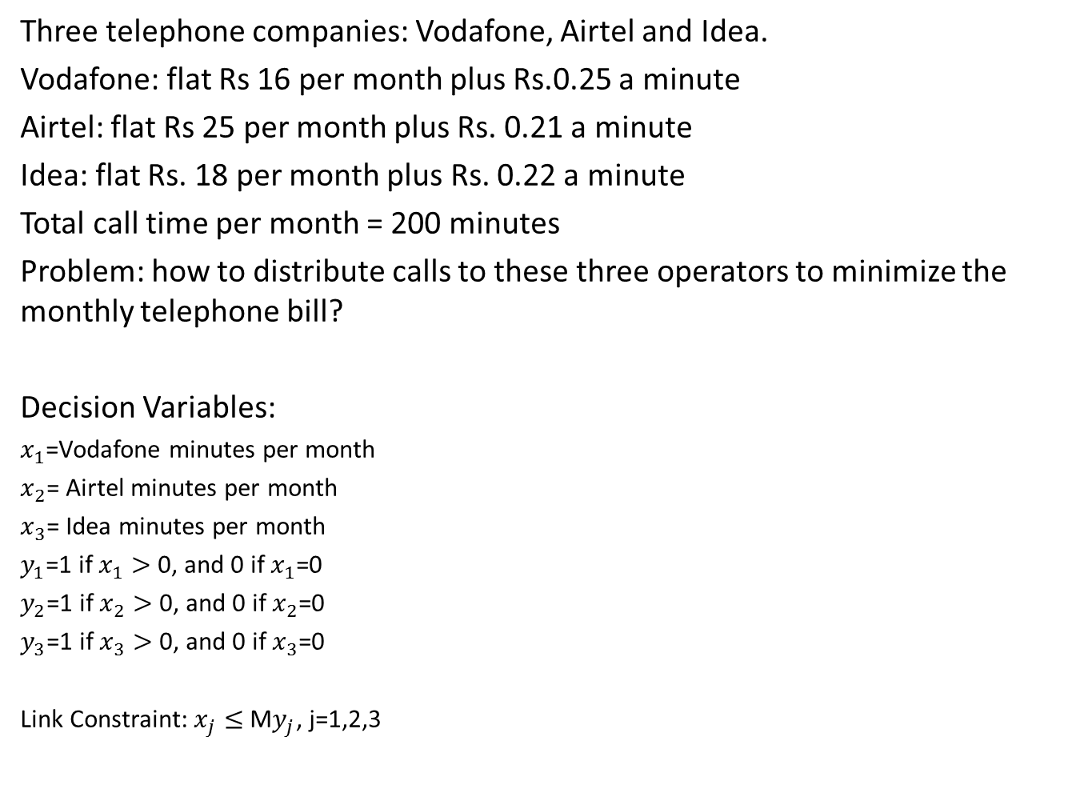
Fixed Charge Problem
Three telephone companies: Vodafone, Airtel and Idea.
Vodafone: flat Rs 16 per month plus Rs.0.25 a minute
Airtel: flat Rs 25 per month plus Rs. 0.21 a minute
Idea: flat Rs. 18 per month plus Rs. 0.22 a minute
Total call time per month = 200 minutes
Problem: how to distribute calls to these three operators to minimize the monthly telephone bill?
Decision Variables:
$x_{1}$=Vodafone minutes per month
$x_{2}$= Airtel minutes per month
$x_{3}$= Idea minutes per month
$y_{1}$=1 if $x_{1}>$ 0, and 0 if $x_{1}$=0
$y_{2}$=1 if $x_{2}>$ 0, and 0 if $x_{2}$=0
$y_{3}$=1 if $x_{3}>$ 0, and 0 if $x_{3}$=0
Link Constraint:$x_{j}≤$M$y_{j}$, j=1,2,3

Slide 14
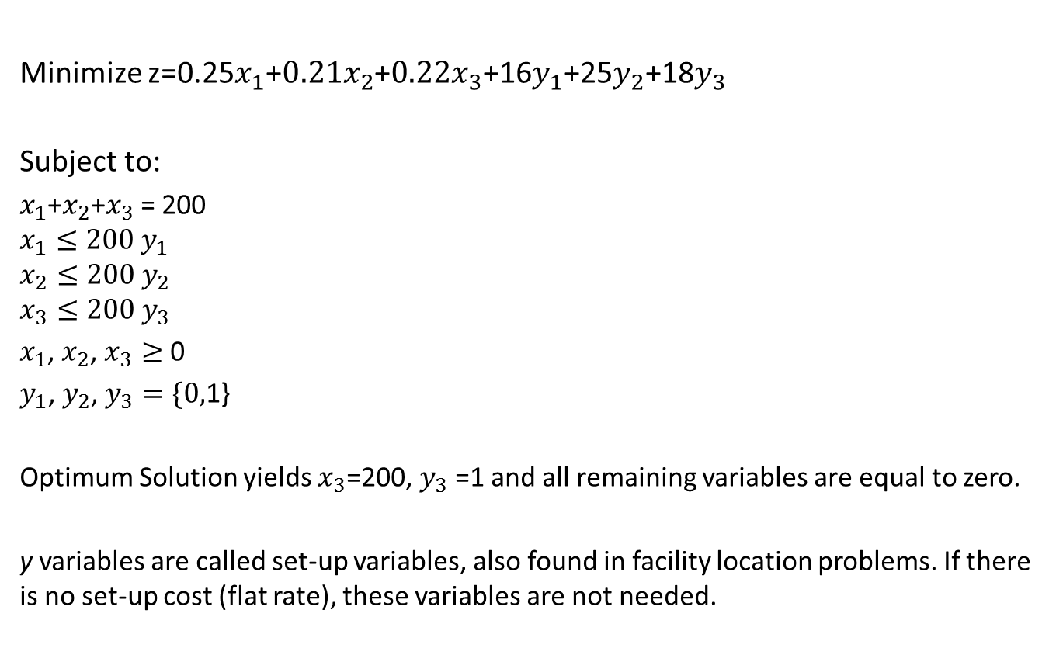
Formulation
Minimize z=0.25$x_{1}$+$0.21x_{2}$+$0.22x_{3}$+16$y_{1}$+25$y_{2}$+18$y_{3}$
Subject to:
$x_{1}$+$x_{2}$+$x_{3}$ = 200
$$x_{1}≤200 y_{1}$$
$$x_{2}≤200 y_{2}$$
$$x_{3}≤200 y_{3}$$
$x_{1}$, $x_{2}$, $x_{3}≥$ 0
$y_{1}$, $y_{2}$, $y_{3}=\{0,$1}
Optimum Solution yields $x_{3}$=200, $y_{3}$ =1 and all remaining variables are equal to zero.
y variables are called set-up variables, also found in facility location problems. If there is no set-up cost (flat rate), these variables are not needed.

Slide 15
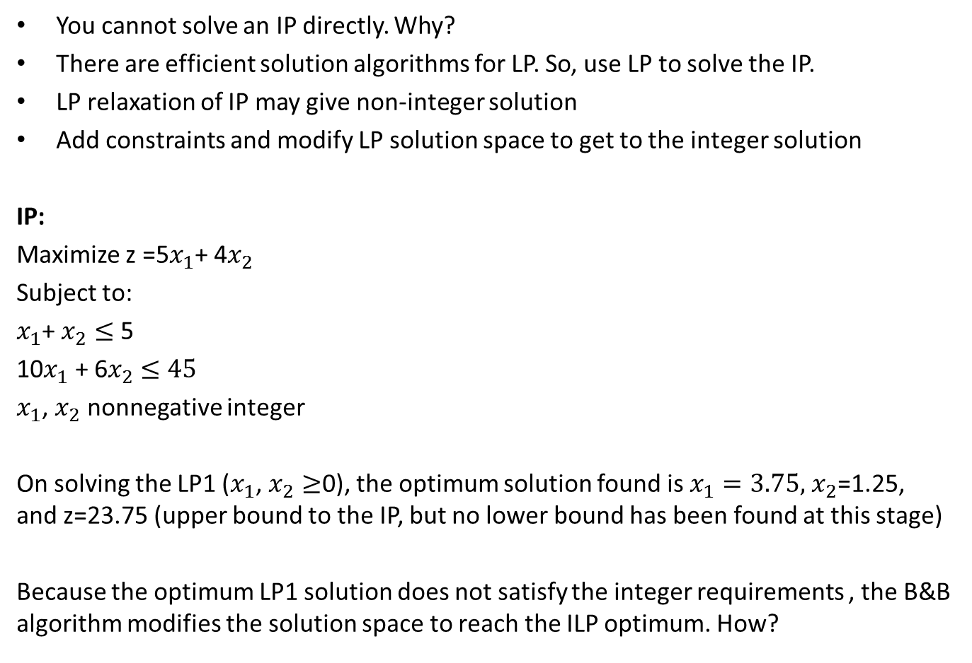
Branch & Bound Algorithm
You cannot solve an IP directly. Why?
There are efficient solution algorithms for LP. So, use LP to solve the IP.
LP relaxation of IP may give non-integer solution
Add constraints and modify LP solution space to get to the integer solution
IP:
Maximize z =5$x_{1}$+ 4$x_{2}$
Subject to:
$x_{1}$+ $x_{2}≤$5
10$x_{1}$ + 6$x_{2}$ $≤45$
$x_{1}$, $x_{2}$ nonnegative integer
On solving the LP1 ($x_{1}$, $x_{2}≥$0), the optimum solution found is $x_{1}=3.75,$ $x_{2}$=1.25, and z=23.75 (upper bound to the IP, but no lower bound has been found at this stage)
Because the optimum LP1 solution does not satisfy the integer requirements , the B&B algorithm modifies the solution space to reach the ILP optimum. How?

Slide 16
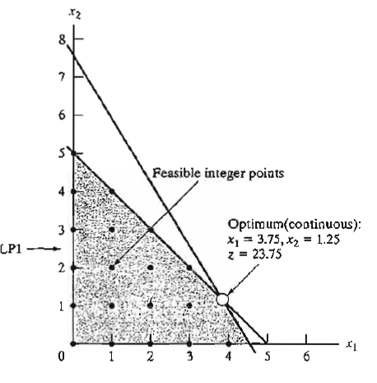
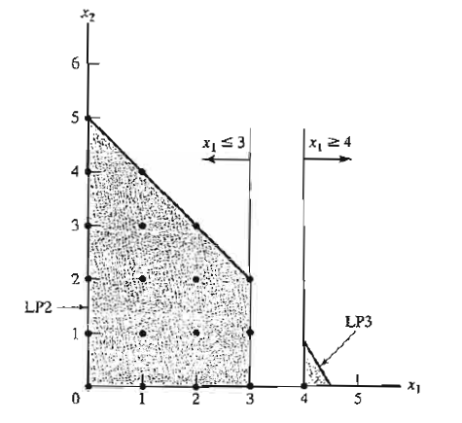
Source: Taha(2002)

Slide 17
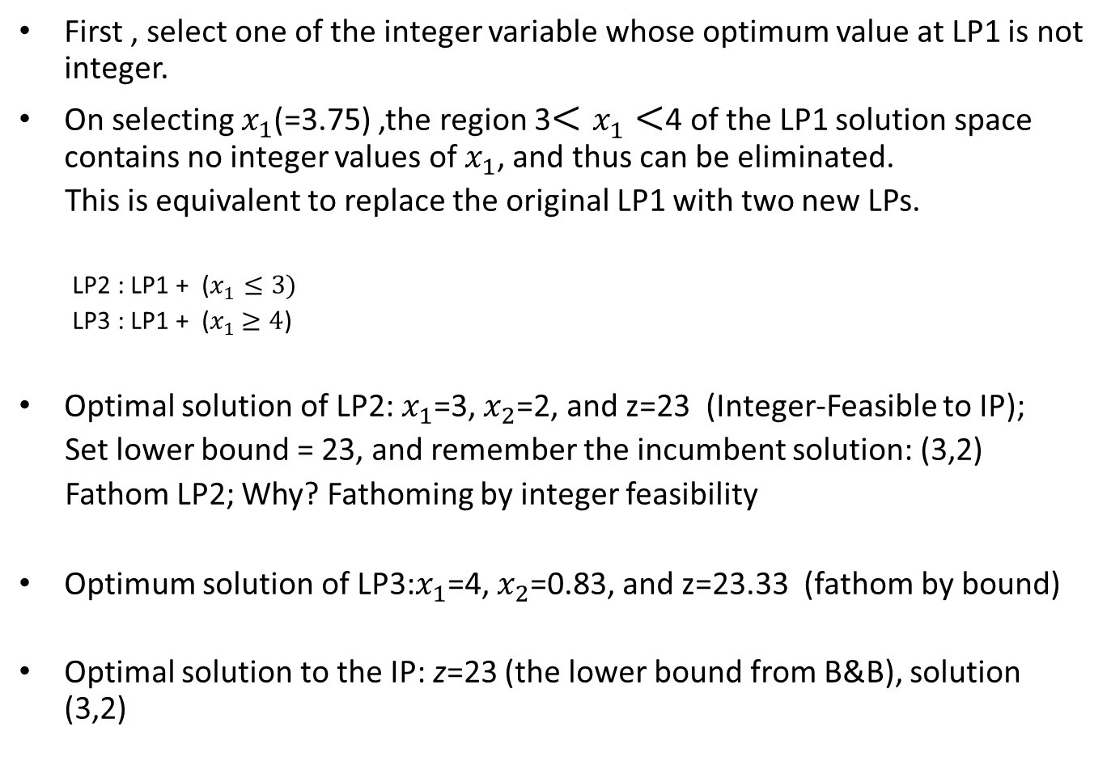
Illustration of B&B Algorithm
First , select one of the integer variable whose optimum value at LP1 is not integer.
On selecting $x_{1}$(=3.75) ,the region 3$<x_{1}<$4 of the LP1 solution space contains no integer values of $x_{1}$, and thus can be eliminated.
This is equivalent to replace the original LP1 with two new LPs.
LP2 : LP1 + ($x_{1}≤3)$
LP3 : LP1 + ($x_{1}$ $≥4$)
Optimal solution of LP2: $x_{1}$=3, $x_{2}$=2, and z=23 (Integer-Feasible to IP);
Set lower bound = 23, and remember the incumbent solution: (3,2)
Fathom LP2; Why? Fathoming by integer feasibility
Optimum solution of LP3:$x_{1}$=4, $x_{2}$=0.83, and z=23.33 (fathom by bound)
Optimal solution to the IP: z=23 (the lower bound from B&B), solution (3,2)

Slide 18
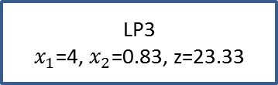
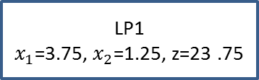
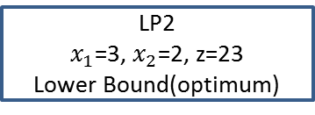
B&B tree
LP2 provide a lower bound on optimum objective value of the original ILP
LP1
$x_{1}$=3.75, $x_{2}$=1.25, z=23 .75
LP2
$x_{1}$=3, $x_{2}$=2, z=23
Lower Bound(optimum)
LP3
$x_{1}$=4, $x_{2}$=0.83, z=23.33

Slide 19





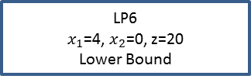





B&B tree if LP3 is solved before LP2
0
LP1
$x_{1}$=3.75, $x_{2}$=1.25, z=23 .75
$$x_{1}≤3$$
$x_{1}≥$4
1
2
LP2
$x_{1}$=3, $x_{2}$=2, z=23
New Lower Bound(Optimum)
LP3
$x_{1}$=4, $x_{2}$=0.83, z=23 .33
$x_{2}≤$0
$x_{2}≥$1
4
3
LP4
$x_{1}$=4.5, $x_{2}$=0, z=22.5
LP5
No feasible solution
$x_{1}≤$4
$x_{1}≥$5
6
5
LP6
$x_{1}$=4, $x_{2}$=0, z=20
Lower Bound
LP7
No feasible solution

Slide 20
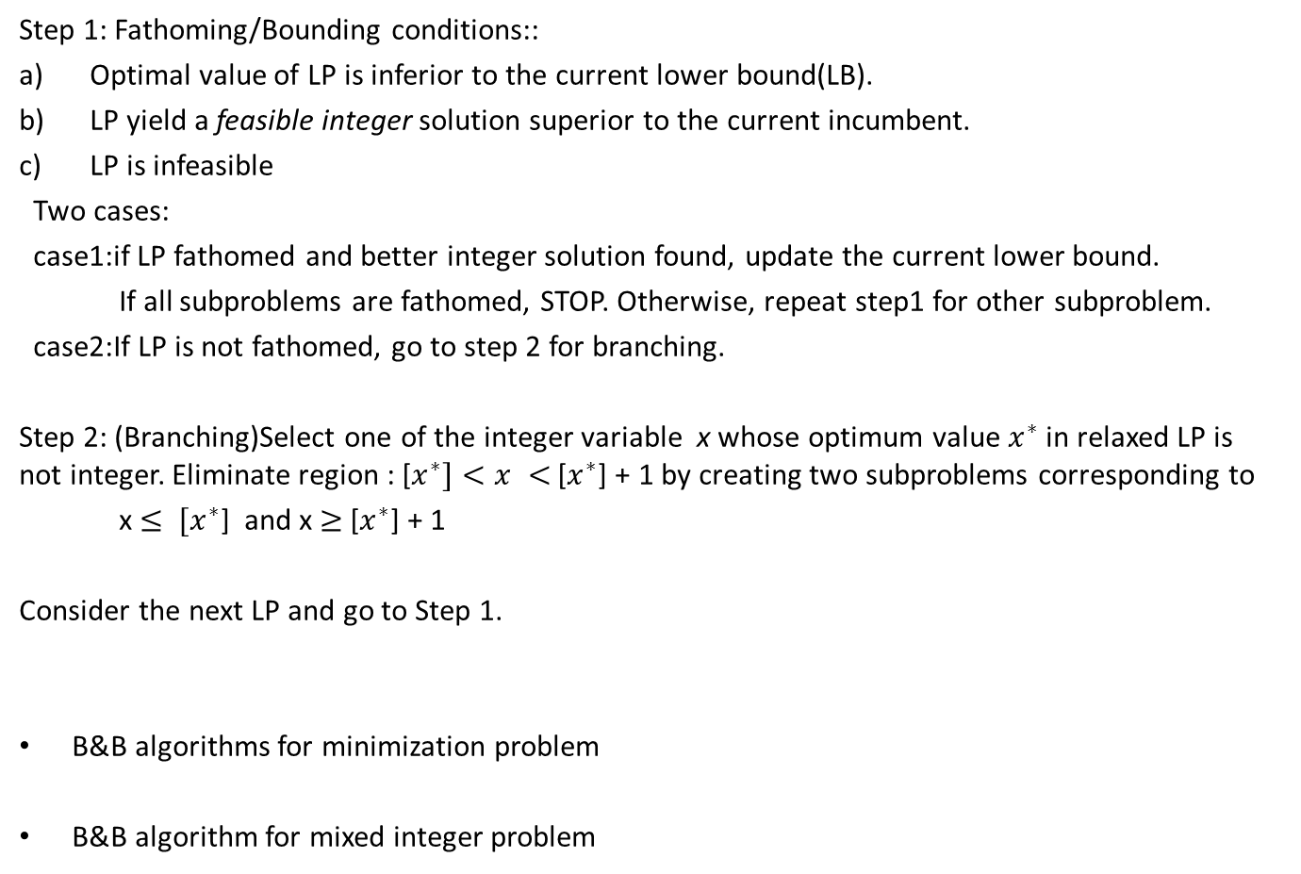
Summary of the B&B Algorithm (maximization problem)
Step 1: Fathoming/Bounding conditions::
Optimal value of LP is inferior to the current lower bound(LB).
LP yield a feasible integer solution superior to the current incumbent.
LP is infeasible
Two cases:
case1:if LP fathomed and better integer solution found, update the current lower bound.
If all subproblems are fathomed, STOP. Otherwise, repeat step1 for other subproblem.
case2:If LP is not fathomed, go to step 2 for branching.
Step 2: (Branching)Select one of the integer variable x whose optimum value $x_{}^{∗}$ in relaxed LP is not integer. Eliminate region : [$x_{}^{∗}]<x <$[$x_{}^{∗}$] + 1 by creating two subproblems corresponding to
x $≤ {[x}_{}^{∗}$] and x $≥$[$x_{}^{∗}$] + 1
Consider the next LP and go to Step 1.
B&B algorithms for minimization problem
B&B algorithm for mixed integer problem

Slide 21
Thank you for your attention

